Slide 1
Sign-In!!!
signin.rvapt.ritsec.club

Slide 2
RVAPT - 2
Passive Enumeration

Slide 3
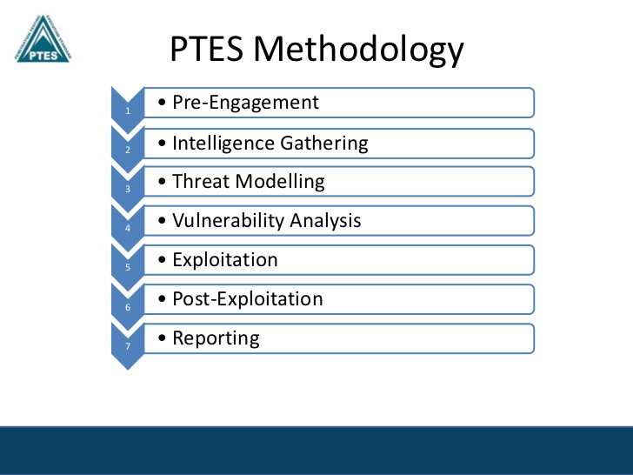
Agenda
Intelligence/Information Gathering
What is Passive Enumeration?
Real World Usage
Tools & Frameworks
Warning
Lab Time

Slide 4
Intelligence/Information Gathering
"Intelligence(Information) Gathering is performing reconnaissance against a target to gather as much information as possible to be utilized when penetrating the target during the vulnerability assessment and exploitation phases." - PTES
Terminology - Intelligence Gathering, Enumeration
Intelligence Gathering → Umbrella term
Active Enumeration → Gathering information through active interaction
Passive Enumeration / OSINT
Vague terminologies → “Enumeration”

Slide 5
Why Enumerate?

Slide 6
Enumeration
Offensive Security Fundamentals
Target, Research, (struggle), Exploitation, Report
Importance
“If you know the enemy and know yourself, you need not fear the result of a hundred battles” - Sun Tzu
Key Questions
What is it?
What is the context?
What does it do?
What can I get from it?
What do I need?
Time Management

Slide 7

Passive Enumeration
Enumeration performed without directly interacting with the target
Archived information
Indexed information
OSINT: Open Source Intelligence
“Interaction”
No network traffic between two party
Purpose
Create a profile, Look at the Big Picture
Set the environment
Actually gain sensitive information

Slide 8
What can we get out of OSINT?

Slide 9
Passive Enumeration - 2
Target
Usually Organizations
Types of Information
Physical
Human Resources - Org Chart
Metadata
Infrastructure Asset
Network block, Subdomains, Tech stacks, Applications
Financial
Archives - Wayback machine
Employees
Assets

Slide 10
Real World Usage
Red Team Engagement
Initial foothold
Phishing
Adversary Simulation
Physical security
Penetration Testing
External Penetration Testing
Have I Been Pwned?
Cred re-usage, Credential stuffing

Slide 11
Tools & Framework - 1
osintframework.com
Provides big picture
Not the most accurate
Search Engines
Google - Google dorking - (exploit-db.com/google-hacking-database)
DuckDuckgo
Baidu - China
Yandex - Russia
Nation-specific search engines
Shodan.io
Scans the internet for devices and services
Great for asset discovery
Notes:
15 Mins

Slide 12
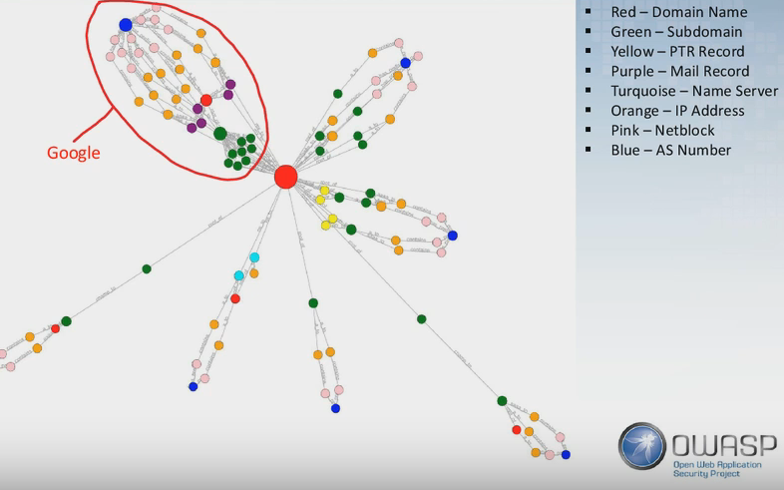
Tools & Framework - 2
theHarvester (@Matt)
Great overall OSINT tool
Performs in-depth OSINT if you have various API keys for different services
Shodan
Github
Spyse
Spiderfoot v.3
Recon-ng
Amass
Maltego

Slide 13

OSINT / Passive Enumeration

Slide 14
Warning
It is still, Grey
Depends on the organization / target
Might appreciate findings, might not
Is accessing sensitive data that was made public by the target, legal? Illegal?
Know what you are doing Know what the tools are doing
Zone Transfer → (python3 tool.py --techniques=all)
2 Ways
A) Responsibly + Privately disclose to target
Bug Bounty !
B) RUN DUDE - Walk away

Slide 15

Case Study - 1
[REDACTED]
More organizations, more individuals performing business tasks online
Usage of web services
Laziness, Mistakes, Lack of Knowledge
Interns beware
Stephanie “Snow” Carruthers

Slide 16

Case Study - 2
@Matt + Macy’s
Open database on internet
No auth
Employee information
???
Responsible + Private disclosure
Contact corresponding personnel
Professional Report
Point of Contact rewarded
Moral:
Be respectful
Go through proper disclosure

Slide 17
Lab Time!

Slide 18
Lab !
Pick a target organization
Perform OSINT using at least 3 tools/frameworks
Practice
Find out things that you did not know before about the organization
theHarvester, Recon-ng, Spiderfoot v.3
Serious
Create a profile of the target
Find weakness/weakest point that could be used for Red Team Engagement

Slide 19
Random Notes
Free shodan Pog god bless america (https://help.shodan.io/the-basics/account-faq)
Do LIVE OSINT along with the presentation
Ask people to share the screen upon finding “the good stuff”
Reinforce OSINT related TTP
TTP by each domain (people, location, code, image, email format, dns, etc.)

